Slide 1
Analysing Amazon Reviews: Insights into Customer Sentiment and Preferences
Group -5
Darshan Hihoriya
[2020004500210018]
Kenil Thakkar
[2020004500210084]
Guided By
Dr. Jignesh Doshi

Slide 2
INTRODUCTION
Our project, "Analysing Amazon Reviews: Insights into Customer Sentiment and Preferences," aims to utilize advanced data science techniques to extract valuable insights from the vast pool of Amazon reviews, providing businesses with actionable information to enhance their products and services.
Through meticulous analysis of language patterns and sentiments expressed in customer reviews, we strive to uncover underlying preferences, identify popular features, and pinpoint areas for improvement, enabling businesses to better understand and cater to the needs of their customers.
By delving beyond surface-level observations, our project seeks to reveal nuanced trends and common themes within Amazon reviews, empowering businesses to make informed decisions and optimize their strategies based on genuine customer feedback.

Slide 3
Objective
Leveraging Bagging, Boosting, LSTM, and sentiment analysis techniques, our project effectively processes vast volumes of Amazon reviews using Natural Language Processing (NLP) algorithms. Through this comprehensive approach, we extract sentiment polarity, identify key themes, and uncover recurring patterns and preferences expressed by customers across diverse product categories.
By automating the analysis process, our methodology efficiently distills complex review data into actionable insights for businesses, enabling data-driven decision-making and strategic planning. Through a deeper understanding of customer sentiments and preferences, derived from our advanced NLP techniques, businesses can improve product offerings and enhance overall customer satisfaction.

Slide 4
Problem Statement
Develop an NLP-based sentiment analysis model to classify Amazon reviews into positive, negative, or neutral sentiments, considering linguistic nuances.
Extract recurring themes and customer preferences from Amazon reviews using NLP techniques to provide actionable insights for businesses to enhance product offerings.

Slide 5
Data Source
Dataset URL:
https://www.kaggle.com/datasets/kritanjalijain/amazon-reviews
Dataset Category: Amazon Reviews
Dataset is BigData (Unstructure Data)

Slide 6
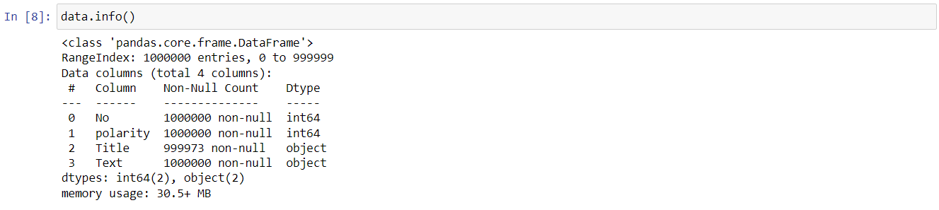
About the Dataset

Slide 7
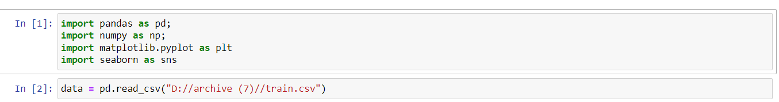
Read File :-

Slide 8
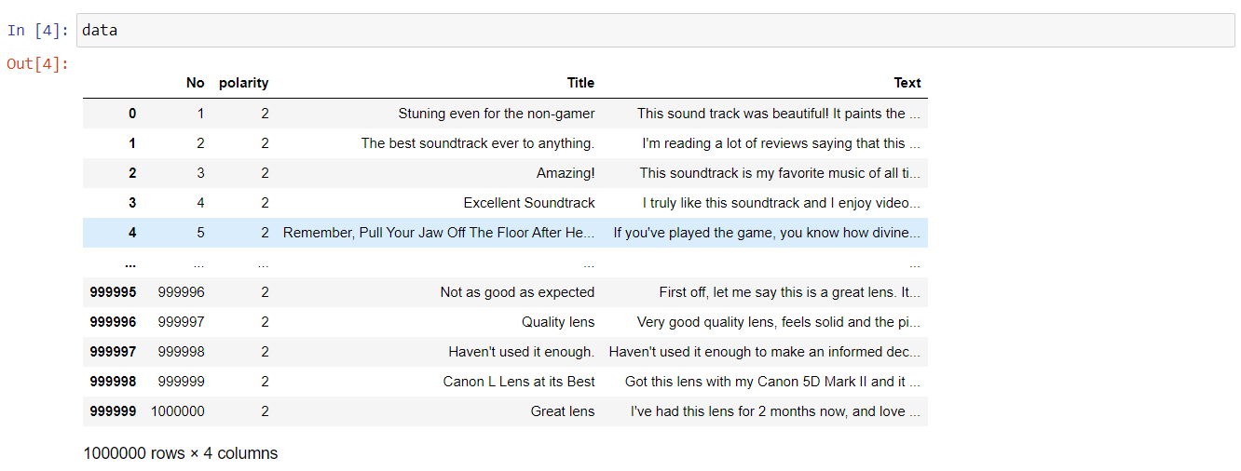
Display Dataset

Slide 9
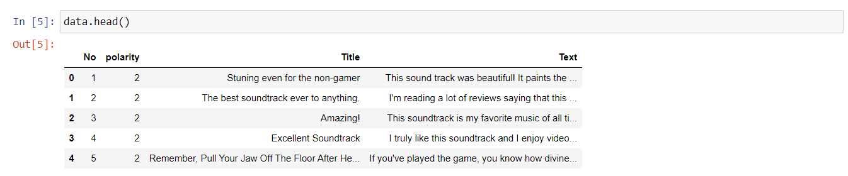
Top 5 Rows Data

Slide 10
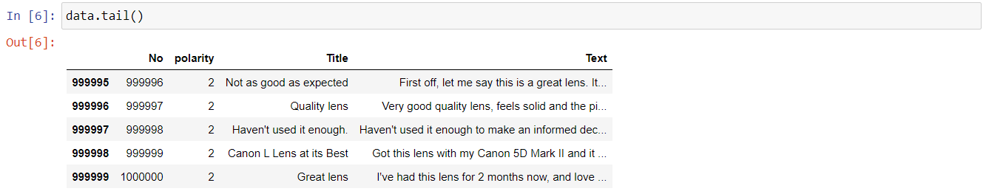
Bottom 5 Rows Data

Slide 11
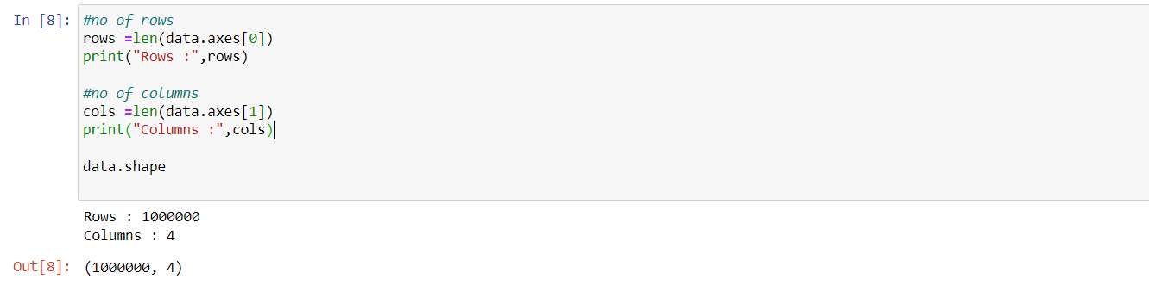
Data Volume

Slide 12
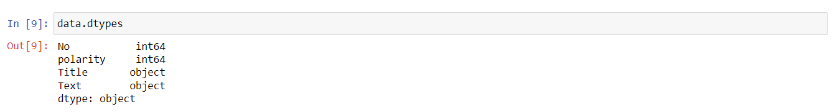
Data Types

Slide 13
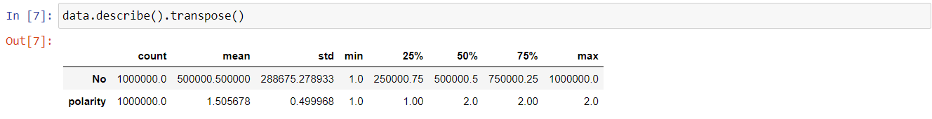
Data Description

Slide 14
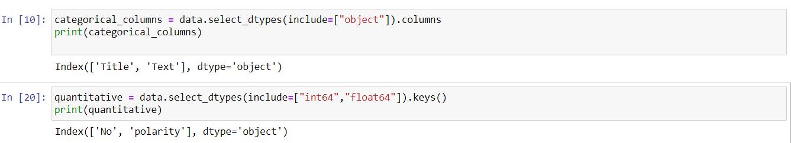
Categorial and Quantitative Data

Slide 15
Note
To facilitate plotting and data analysis, we've extracted a subset of 1,00,000 records from the larger dataset containing more than 3,00,00,000 entries.

Slide 16
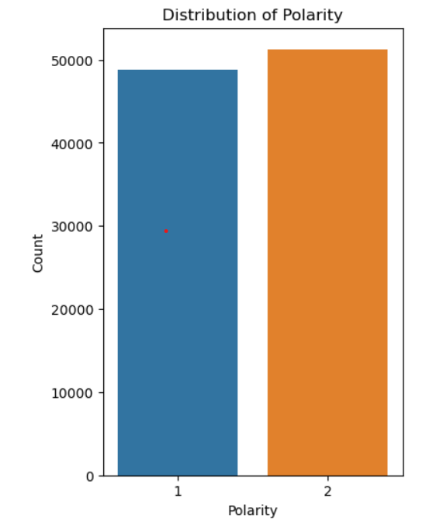
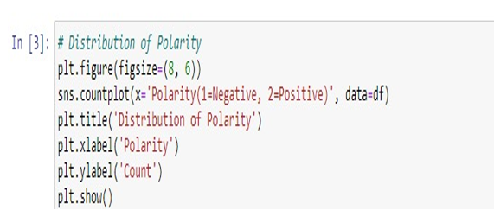
CountPlot

Slide 17
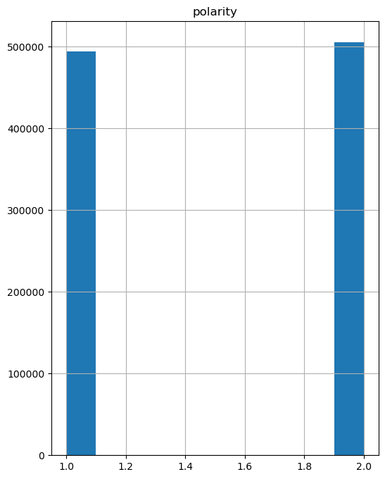
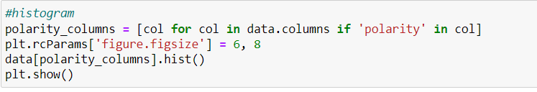
Histogram

Slide 18
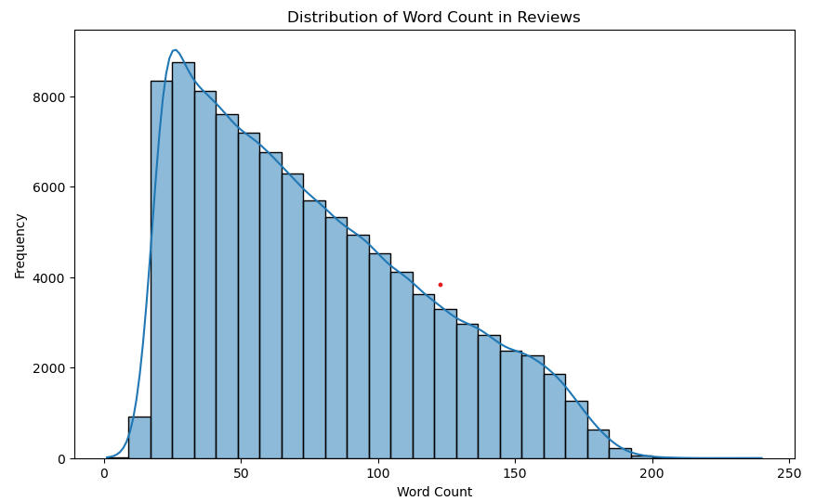
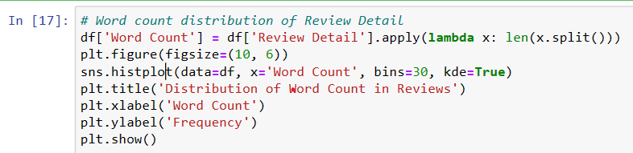
Line with Bar Graph

Slide 19
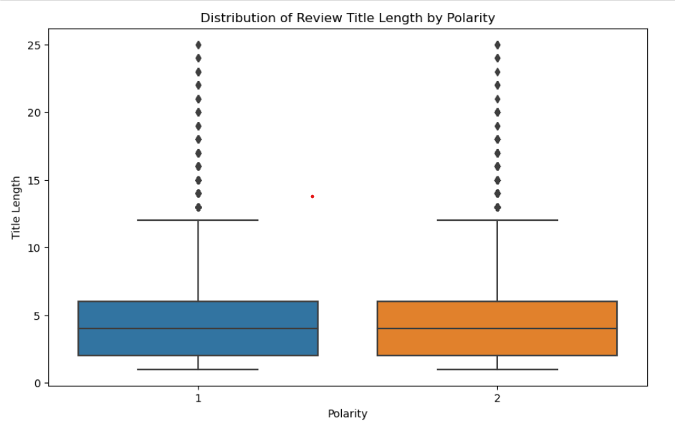
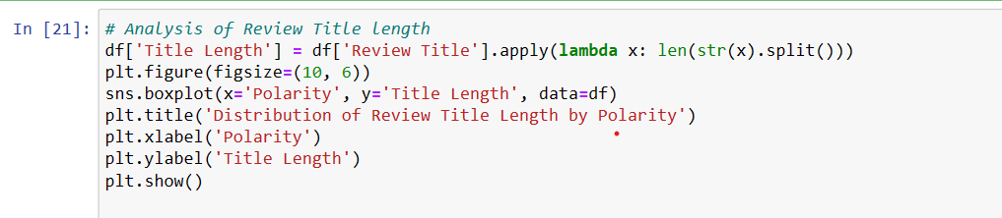
Boxplot

Slide 20
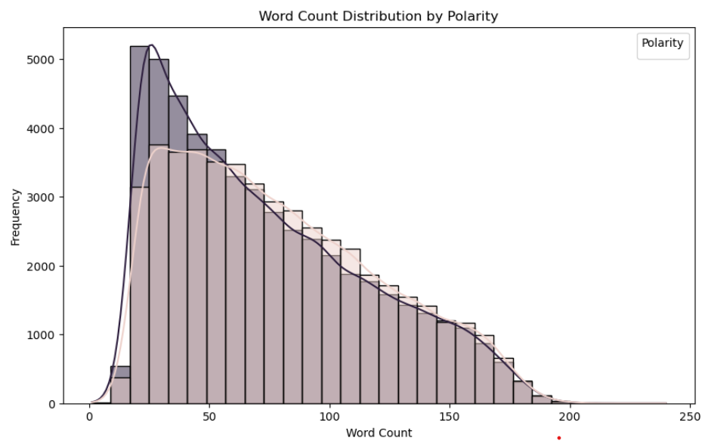
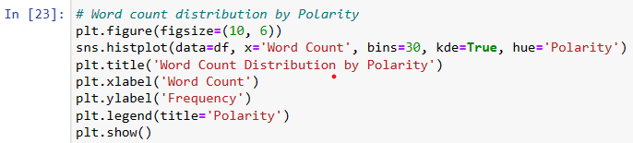
Grouped histogram with KDE(Kernel Density Estimation)

Slide 21
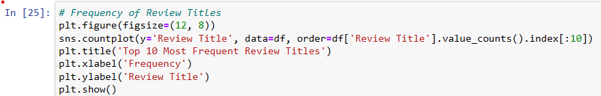
Horizontal Bar Graph(1)

Slide 22
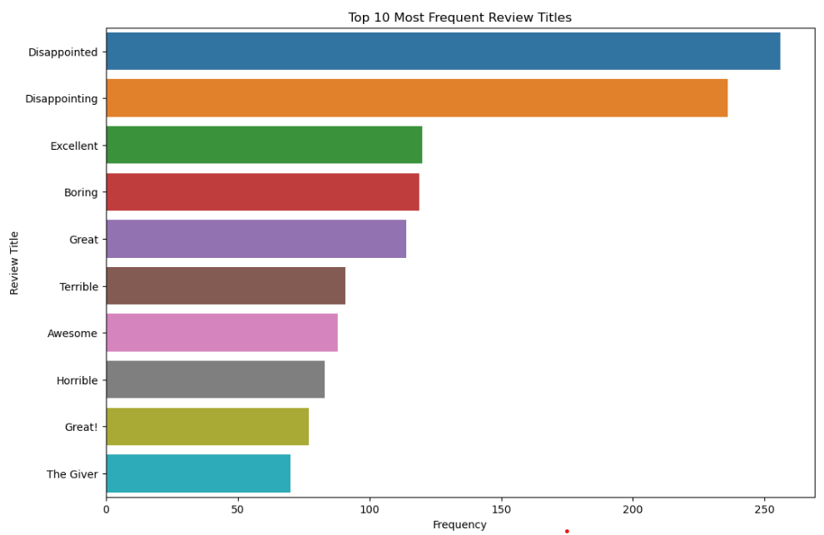
Horizontal Bar Graph(1)

Slide 23
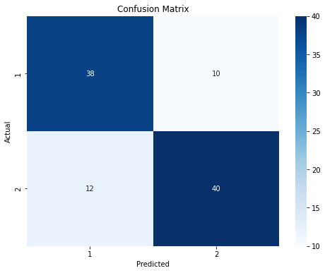
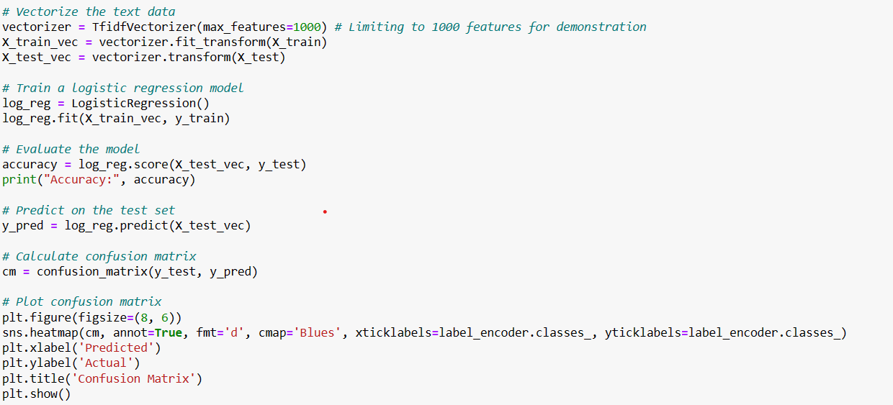
Confusion Matrix

Slide 24
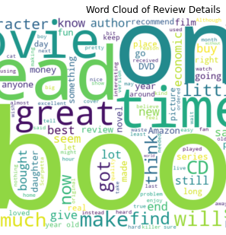
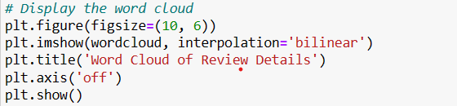
Word Count

Slide 25
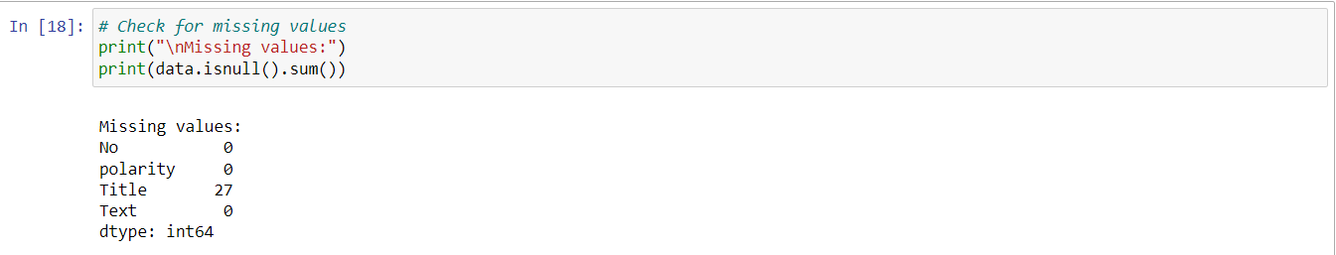
Missing Values Check

Slide 26
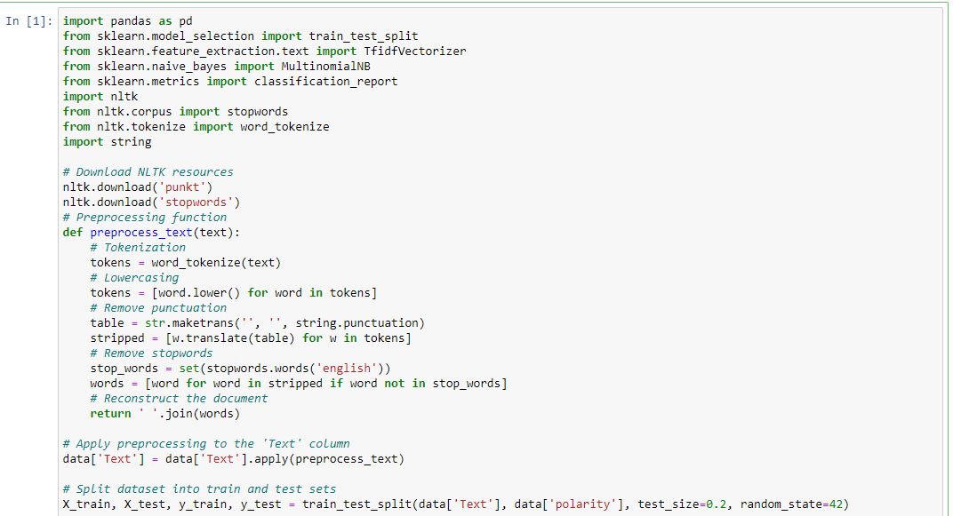
Text Pre Processing

Slide 27
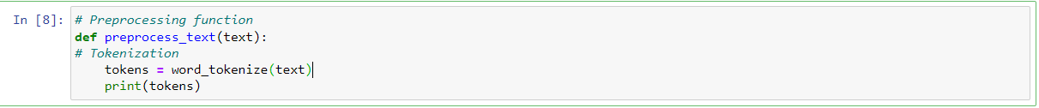
Tokenization
This code utilizes the NLTK library's word_tokenize function to tokenize the input text, breaking it down into individual words and punctuation marks.

Slide 28
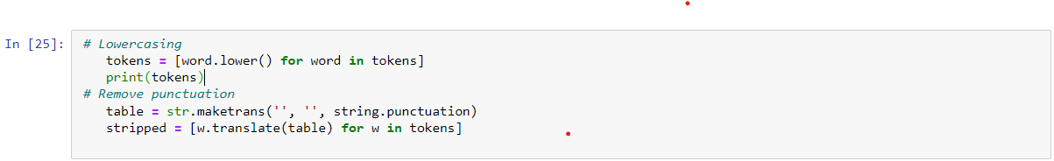
Lowercasing and Remove punctuation
This code converts all words in the list tokens to lowercase using list comprehension, then removes all punctuation characters from each word using str.translate() method and a translation table created by str.maketrans('', '', string.punctuation).

Slide 29
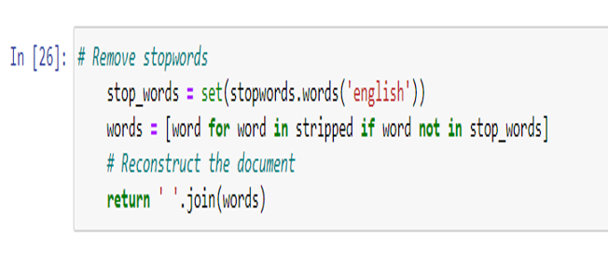
Remove stop-word and Reconstruct
This code removes stopwords from a text document and reconstructs it into a string without those stopwords.

Slide 30
Model 1 :Bagging Boosting
Bagging (Bootstrap Aggregating) and Boosting are ensemble learning techniques aimed at improving the performance of machine learning models. Bagging builds multiple base models using random subsets of the training data and aggregates their predictions to reduce variance and overfitting. Boosting, on the other hand, sequentially builds models, focusing more on instances that are difficult to classify correctly, thereby improving predictive accuracy.

Slide 31
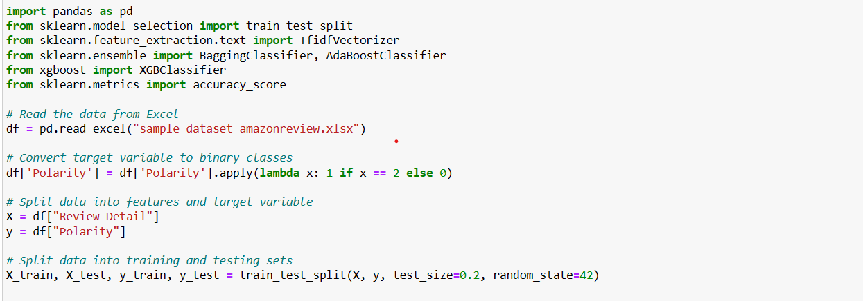
Bagging Boosting [1]

Slide 32
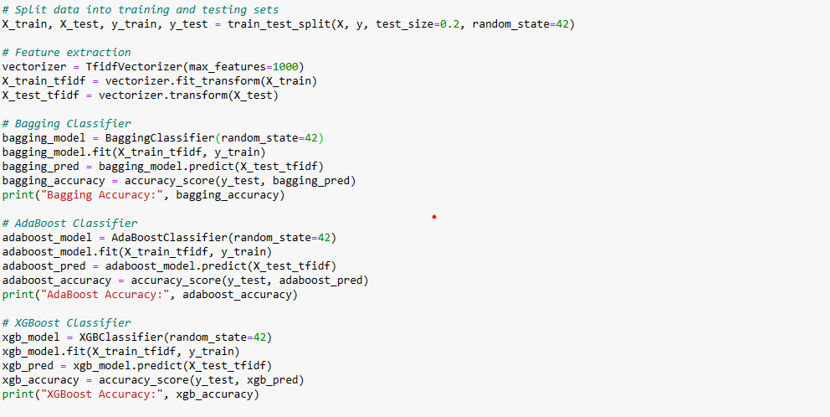

Bagging Boosting [2]

Slide 33
Output(Bagging Boosting )
Bagging Accuracy: This represents the accuracy achieved by the bagging classifier. It indicates that the bagging ensemble model correctly predicted the polarity of approximately 69% of the reviews in the test set.
Boosting Accuracy: This represents the accuracy achieved by the boosting classifier. It indicates that the boosting ensemble model correctly predicted the polarity of approximately 65% of the reviews in the test set.

Slide 34
Model-2:LSTM (Long Short Term Memory)
LSTM (Long Short-Term Memory) networks are a specialized type of recurrent neural network (RNN) architecture, designed to address the limitations of traditional RNNs in capturing long-term dependencies in sequential data.
Unlike standard RNNs, LSTM units contain memory cells equipped with gating mechanisms that regulate the flow of information, allowing them to selectively retain and update relevant information over time.
LSTM networks have found wide application in data science for tasks such as time-series forecasting, natural language processing (NLP), and speech recognition, thanks to their ability to effectively model and predict patterns in sequential data while mitigating the vanishing gradient problem.

Slide 35
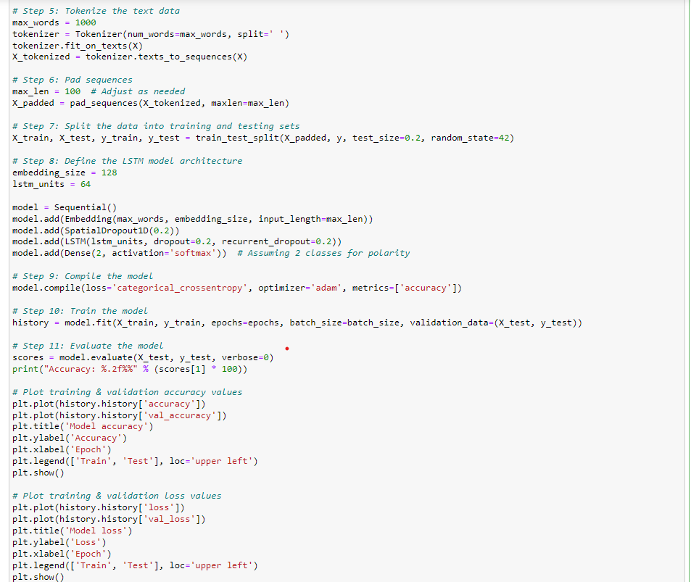
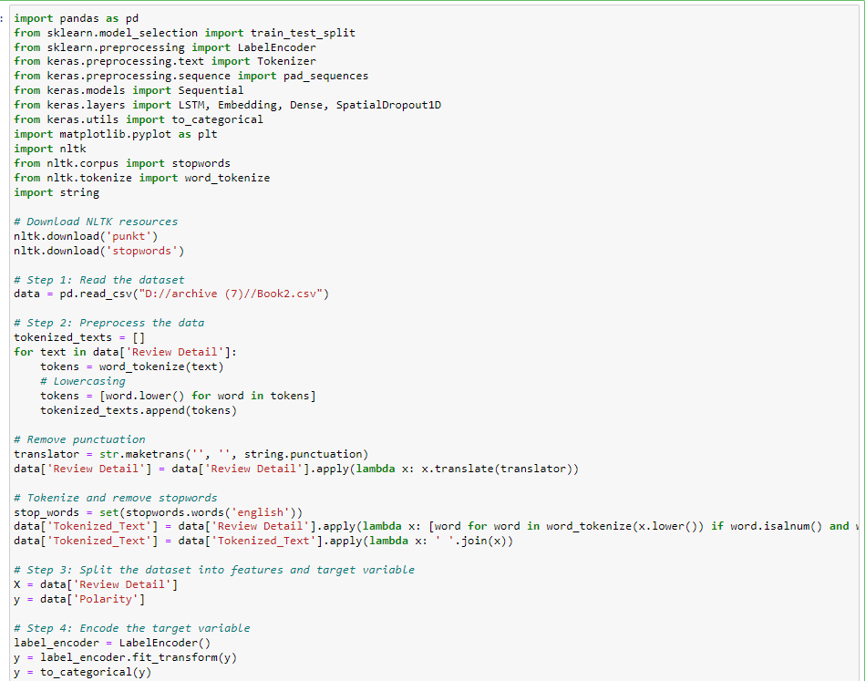
Preprocessing and finding Accuracy from LSTM

Slide 36
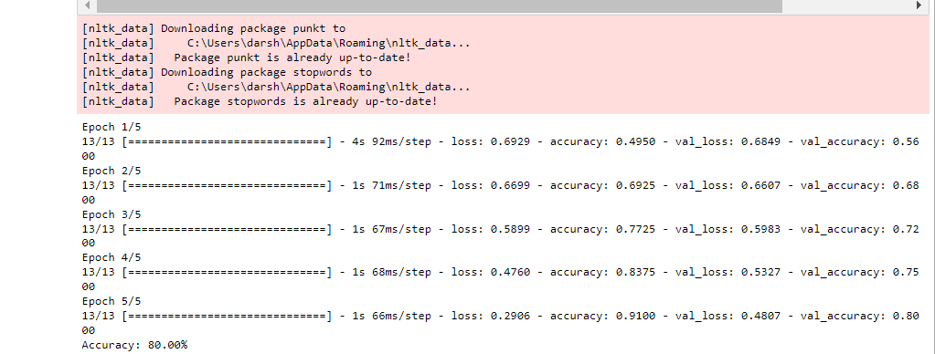
Output For LSTM with Accuracy

Slide 37
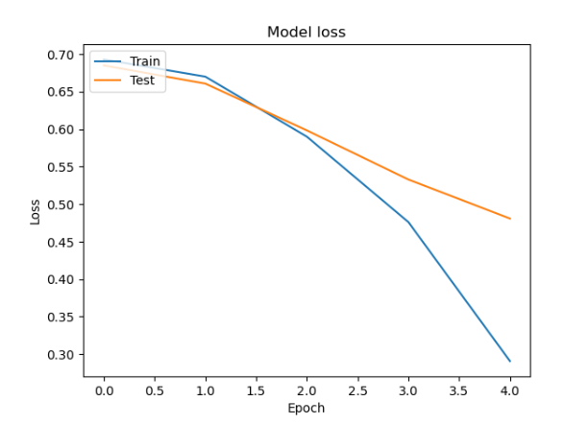
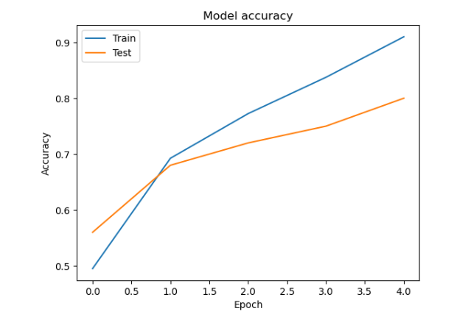
Graphs for Accuracy and Model Loss

Slide 38
Model-3:Sentiment Analysis
Sentiment analysis is a subfield of natural language processing (NLP) focused on automatically identifying and categorizing the sentiment expressed in textual data, such as positive, negative, or neutral.
Techniques for sentiment analysis range from simple rule-based methods to complex machine learning algorithms, including supervised learning with labeled datasets, unsupervised learning with lexicon-based approaches, and deep learning models like recurrent neural networks (RNNs) or transformers.
Applications of sentiment analysis span various domains, including social media monitoring, customer feedback analysis, brand reputation management, market research, and financial analysis, enabling businesses to gain insights into public opinion and customer sentiment for informed decision-making.

Slide 39
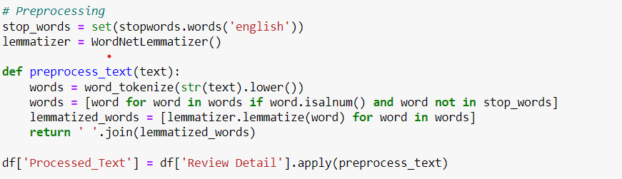
Sentiment Preprocessing

Slide 40
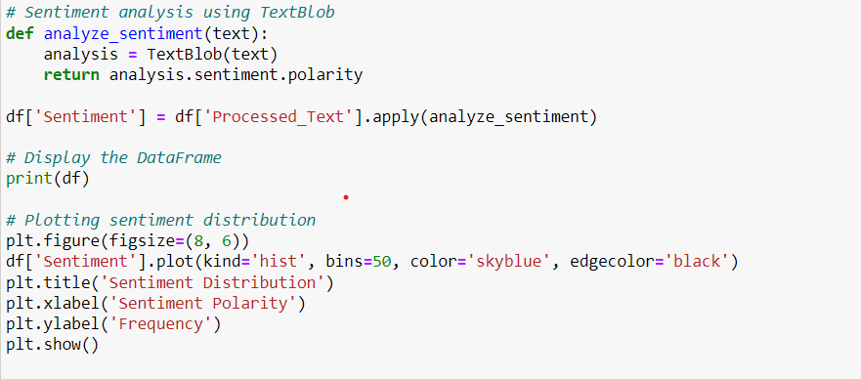
Sentiment Analysis using TextBlob

Slide 41
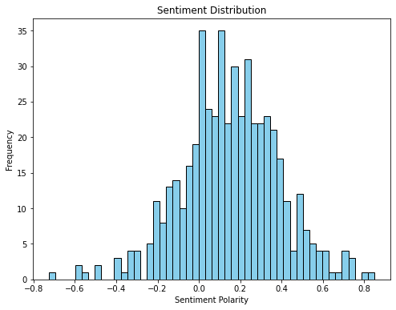
Sentiment Results
The graph's right-skewed distribution, with more bars concentrated on the positive polarity side, suggests that a significant majority of reviews express positive sentiment towards the subject matter. This positive skew indicates that customers generally found the reviewed products or services satisfactory, enjoyable, or beneficial. The prevalence of positive sentiment underscores the favorable reception of the products or services among consumers, potentially reflecting high-quality experiences, exceptional features, or effective performance

Slide 42
Summary of All Models Applied
Ensemble Models (Bagging and Boosting):
Bagging achieved an accuracy of approximately 69%, while boosting achieved around 65% accuracy in predicting review polarity.
Both methods demonstrated effective performance in classifying sentiment, with bagging slightly outperforming boosting.
Ensemble methods provide robust solutions for sentiment analysis tasks by leveraging multiple base learners to improve prediction accuracy.
Long Short-Term Memory (LSTM) Model:
The LSTM model attained an impressive accuracy of 80% in predicting review polarity.
Its recurrent neural network architecture enables it to capture contextual dependencies in text data, leading to more accurate sentiment predictions.
LSTM demonstrates superior performance compared to ensemble models, showcasing its effectiveness in handling sequential data like text.
Sentiment Analysis Insights:
Graphical representation reveals a right-skewed distribution, indicating a prevalence of positive sentiment in Amazon reviews.
Majority of reviews express satisfaction, enjoyment, or approval towards the reviewed products or services.
The positive skew underscores the favourable reception of products/services among consumers, reflecting high-quality experiences and effective performance.

Slide 43
Conclusion
Ensemble models, LSTM, and sentiment analysis collectively provide valuable insights into the sentiment expressed in Amazon reviews.
While ensemble models offer respectable accuracies, LSTM demonstrates superior performance in capturing contextual information.
The overwhelming positive sentiment highlights the favorable reception of products or services among consumers, suggesting high-quality experiences and effective performance.

Slide 44
Thank You

